Slide 1
Meeting Template M. T.
Quality Department
Al-Noor Hospital
Abdulaziz Alsulami

Slide 2
Object
Save time and effort
More organized and attractive
Presenting value in details
Depending on an electronic report instead of papers
High precision “Quality” and easy to reach the information

Slide 3
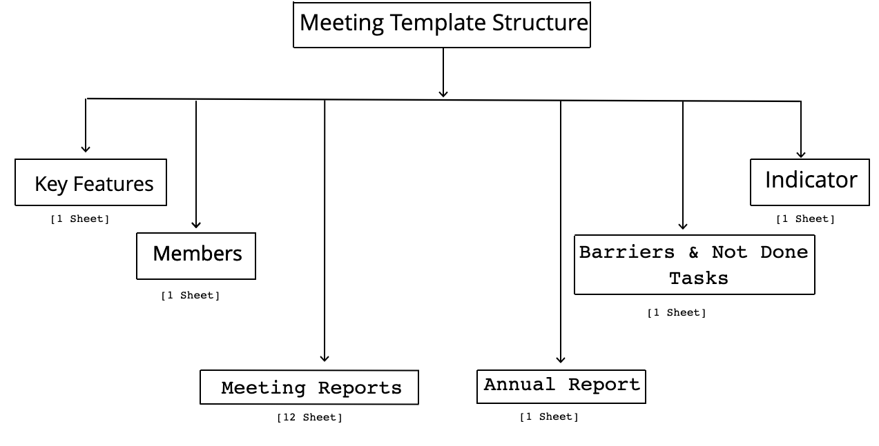
Meeting Tmeplate Structure

Slide 4
Key Features
All necessary information in a drop list which the user can select from them.
Day
Date
Year
Duration (Meeting)
Time (Starting the Meeting)
Number of Meeting (Annual Report)

Slide 5
Members
Members who will being every meeting.
Name
Job title

Slide 6
Meeting Reports
Monthly meeting report which has all requiered information for meeting.
12 Meeting Reports
List of attented, invetees, apologies and Abcentees
Statistics for each responsible
Subject detailes

Slide 7
Annual Report
It is an outcome of all monthly meeting reports
Statistics Information and graphs
Tasks / Recommendations and Responisbles details

Slide 8
Barrier & Not Done Tasks
This sheet include Task, Responsible and status names for each montly meeting report to find what and how many do barrier and not done tasks have?
12 monthly meeting report
Tasks / Recommendations, Responisbles and status details

Slide 9
Indicator
It includes information of performance indicator

